Slide 1
Chapter 9 Strings and Text I/O

Slide 2
Constructing Strings
String newString = new String(stringLiteral);
String message = new String("Welcome to Java");
Since strings are used frequently, Java provides a shorthand initializer for creating a string:
String message = "Welcome to Java";

Slide 3
String Comparisons
equals
String s1 = new String("Welcome“);
String s2 = "welcome";
if (s1.equals(s2)){
// s1 and s2 have the same contents
}
if (s1 == s2) {
// s1 and s2 have the same reference
}

Slide 4
String Comparisons, cont.
compareTo()
String s1 = new String("Welcome“);
String s2 = "welcome";
if (s1.compareTo(s2) > 0) {
// s1 is greater than s2
}
else if (s1.compareTo(s2) == 0) {
// s1 and s2 have the same contents
}
else
// s1 is less than s2

Slide 5
Finding String Length
Finding string length using the length() method:
message = "Welcome";
message.length()
    returns 7

Slide 6
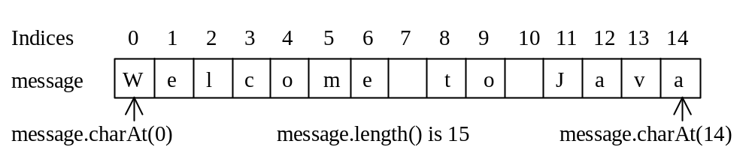
Retrieving Individual Characters in a String
Do not use message[0]
Use message.charAt(index)
Index starts from 0

Slide 7
String Concatenation
String s3 = s1.concat(s2);
String s3 = s1 + s2;
s1 + s2 + s3 + s4 + s5 same as
(((s1.concat(s2)).concat(s3)).concat(s4)).concat(s5);

Slide 8
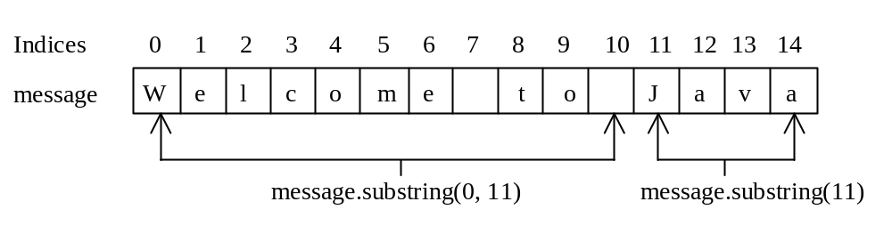
Extracting Substrings
You can extract a single character from a string using the charAt method. You can also extract a substring from a string using the substring method in the String class.
String s1 = "Welcome to Java";
String s2 = s1.substring(0, 11) + "HTML";

Slide 9
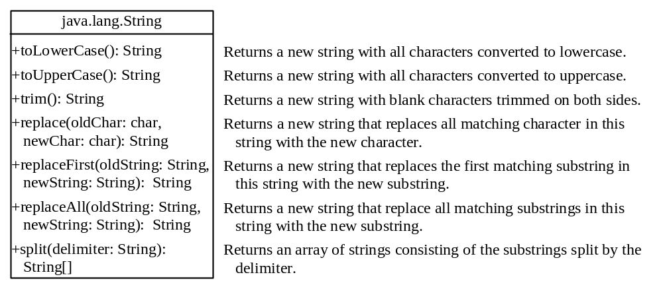
Converting, Replacing, and Splitting Strings

Slide 10
Examples
"Welcome".toLowerCase() returns a new string, welcome.
"Welcome".toUpperCase() returns a new string, WELCOME.
" Welcome ".trim() returns a new string, Welcome.
"Welcome".replace('e', 'A') returns a new string, WAlcomA.
"Welcome".replaceFirst("e", "AB") returns a new string, WABlcome.
"Welcome".replace("e", "AB") returns a new string, WABlcomAB.
"Welcome".replace("el", "AB") returns a new string, WABlcome.

Slide 11
Splitting a String
String[] tokens = "Java#HTML#Perl".split("#", 0);
for (int i = 0; i < tokens.length; i++)
System.out.print(tokens[i] + " ");
displays
Java HTML Perl

Slide 12
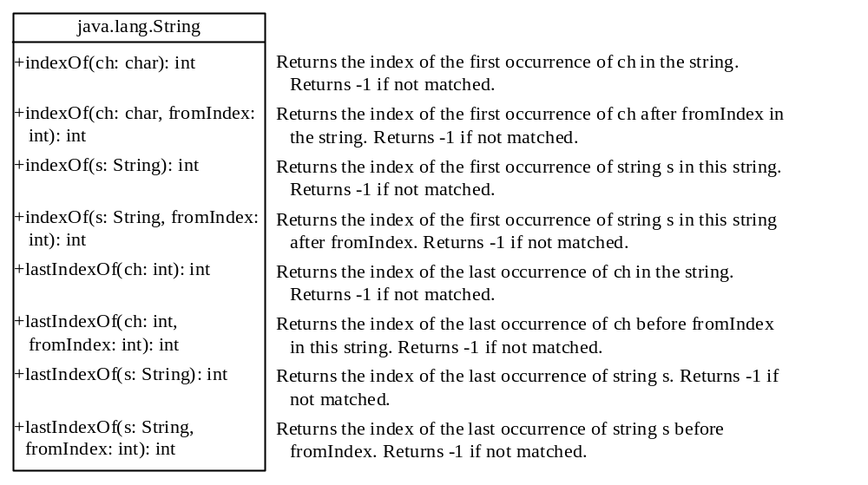
Finding a Character or a Substring in a String

Slide 13
Finding a Character or a Substring in a String
"Welcome to Java".indexOf('W') returns 0.
"Welcome to Java".indexOf('x') returns -1.
"Welcome to Java".indexOf('o', 5) returns 9.
"Welcome to Java".indexOf("come") returns 3.
"Welcome to Java".indexOf("Java", 5) returns 11.
"Welcome to Java".indexOf("java", 5) returns -1.
"Welcome to Java".lastIndexOf('a') returns 14.

Slide 14
Convert Character and Numbers to Strings
The String class provides several static valueOf methods for converting a character, an array of characters, and numeric values to strings. These methods have the same name valueOf with different argument types char, char[], double, long, int, and float. For example, to convert a double value to a string, use String.valueOf(5.44). The return value is string consists of characters ‘5’, ‘.’, ‘4’, and ‘4’.

Slide 15
Problem: Finding Palindromes
Objective: Checking whether a string is a palindrome: a string that reads the same forward and backward.
CheckPalindrome
Run

Slide 16
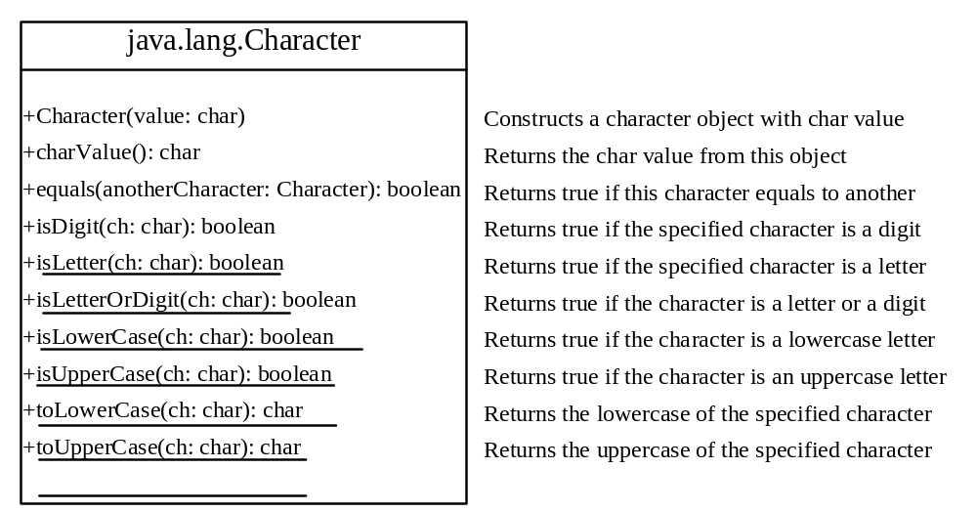
The Character Class

Slide 17
Examples
Character x = new Character('b');
System.out.println(Character.isDigit(x));
//returns false
char x = 'b';
System.out.println(Character.isDigit(x));
//returns false

Slide 18
StringBuilder and StringBuffer
The StringBuilder/StringBuffer class is an alternative to the String class. In general, a StringBuilder/StringBuffer can be used wherever a string is used. StringBuilder/StringBuffer is more flexible than String. You can add, insert, or append new contents into a string buffer, whereas the value of a String object is fixed once the string is created.

Slide 19

Modifying Strings in the Builder

Slide 20
Examples
StringBuilder sb=new StringBuilder("Hello ");
sb.append("Java");
System.out.println(sb);
sb.insert(4, "Sam");
System.out.println(sb);
sb.delete(1,5);
System.out.println(sb);
sb.deleteCharAt(5);
System.out.println(sb);
sb.replace(1,4,"ello");
System.out.println(sb);
sb.setCharAt(4, 'a');
System.out.println(sb);
sb.reverse();
System.out.println(sb);
Hello Java
HellSamo Java
Hamo Java
Hamo ava
Hello ava
Hella ava
ava alleH

Slide 21
The File Class
The File class is intended to provide an abstraction that deals with most of the machine-dependent complexities of files and path names in a machine-independent fashion. The filename is a string. The File class is a wrapper class for the file name and its directory path.

Slide 22
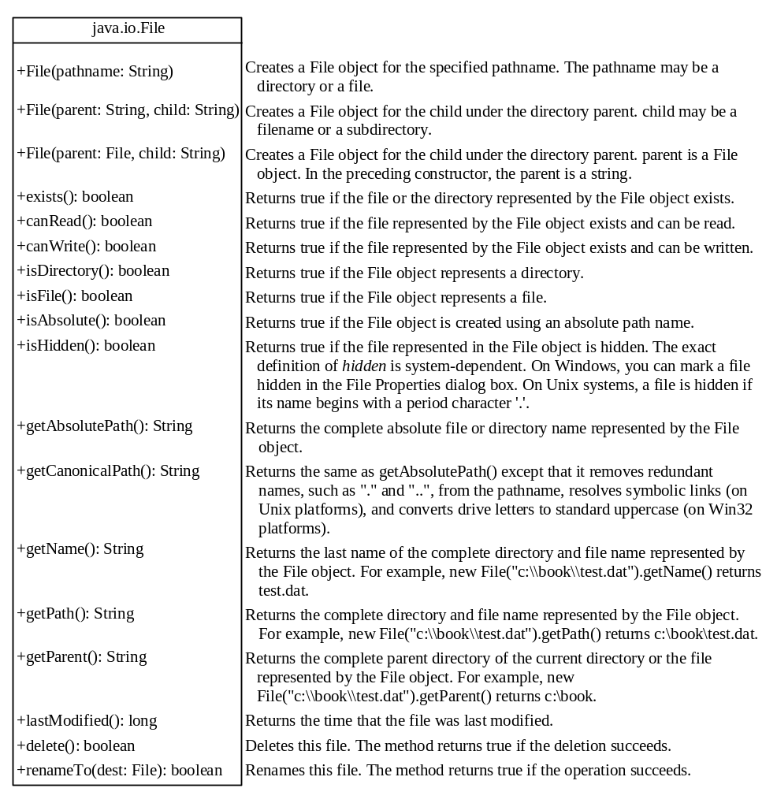
Obtaining file properties and manipulating file

Slide 23

Problem: Explore File Properties
public static void main(String[] args) {
java.io.File file = new java.io.File("c:\\test\\sample.txt");
System.out.println("Does it exist? " + file.exists());
System.out.println("The file has " + file.length() + " bytes");
System.out.println("Can it be read? " + file.canRead());
System.out.println("Can it be written? " + file.canWrite());
System.out.println("Is it a directory? " + file.isDirectory());
System.out.println("Is it a file? " + file.isFile());
System.out.println("Is it absolute? " + file.isAbsolute());
System.out.println("Is it hidden? " + file.isHidden());
System.out.println("Absolute path is " + file.getAbsolutePath());
System.out.println("Last modified on " + new java.util.Date(file.lastModified()));
}
TestFileClass

Slide 24
Text I/O
A File object encapsulates the properties of a file or a path, but does not contain the methods for reading/writing data from/to a file. In order to perform I/O, you need to create objects using appropriate Java I/O classes. The objects contain the methods for reading/writing data from/to a file. This section introduces how to read/write strings and numeric values from/to a text file using the Scanner and PrintWriter classes.

Slide 25
Writing Data Using PrintWriter
import java.io.*;
public class JavaApplication6 {
public static void main(String[] args) throws FileNotFoundException {
File file = new File("c:\\test\\scores.txt");
if (file.exists()) {
System.out.println("File already exists");
System.exit(0);
}
// Create a file
PrintWriter output = new PrintWriter(file);
// Write formatted output to the file
output.print("John T Smith ");
output.println(90);
output.print("Eric K Jones ");
output.println(85);
// Close the file
output.close();
}
}
WriteData

Slide 26
Writing Data Using FileWriter
import java.io.*;
public class JavaApplication6 {
public static void main(String[] args) throws IOException {
String dosya = "c:\\test\\scores.txt";
// Create a file
FileWriter output = new FileWriter(dosya,true);
// Write formatted output to the file
output.write("John T Smith ");
output.write("90\r\n");
output.write("Eric K Jones ");
output.write("85\r\n");
// Close the file
output.close();
}
}
WriteData

Slide 27
Reading Data Using Scanner
import java.io.*;
import java.util.Scanner;
public class JavaApplication6 {
public static void main(String[] args) throws FileNotFoundException {
File file = new File("c:\\test\\scores.txt");
// Create a Scanner for the file
Scanner input = new Scanner(file);
// Read data from a file
while (input.hasNext()) {
String firstName = input.next();
String mi = input.next();
String lastName = input.next();
int score = input.nextInt();
System.out.println(
firstName + " " + mi + " " + lastName + " " + score);
}
// Close the file
input.close();
}
}
ReadData

Slide 28
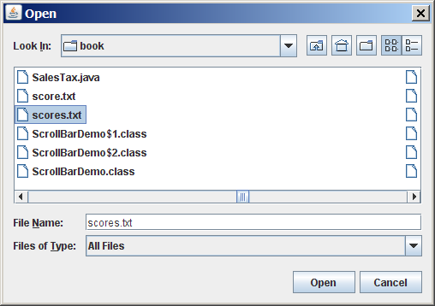
(GUI) File Dialogs
import java.io.*;
import java.util.Scanner;
import javax.swing.JFileChooser;
import javax.swing.JOptionPane;
public class JavaApplication6 {
public static void main(String[] args) throws FileNotFoundException {
JFileChooser fileChooser = new JFileChooser();
if (fileChooser.showOpenDialog(null) == JFileChooser.APPROVE_OPTION) {
// Get the selected file
File file = fileChooser.getSelectedFile();
// Create a Scanner for the file
Scanner input = new Scanner(file);
// Read text from the file
String text = "";
while (input.hasNext()) {
text += input.nextLine() + "\n";
}
JOptionPane.showMessageDialog(null, text);
// Close the file
input.close();
} else {
System.out.println("No file selected");
}
}
}

